Slide 1
#sjsSugendran
Refactoring Legacy Code
@sugendran

Slide 2


#sjsSugendran
Yammer Frontend is a busy place
24 Engineers across 3 offices
5 years of experimentation
Mix of open source and custom frameworks

Slide 3
#sjsSugendran
Refactoring the Thread List
Core component of Yammer
Had the most amount of experimentation
Hard to understand and slow to work with

Slide 4
#sjsSugendran
Don’t hate past team mates
Past decisions were made
for good reason

Slide 5
#sjsSugendran
Rewrite vs Refactor
Time to ship is the most important
Many years of changes and bug fixes
Consider the costs to other projects

Slide 6
#sjsSugendran
Working alone is dangerous
No one works alone at Yammer
On our own we don’t have all the answers
A stubborn person will help keep you honest

Slide 7
#sjsSugendran
Understand the domain
Do you know all the use cases?
Not everything is written down
Limit the scope after the research

Slide 8
#sjsSugendran
Release early, release often
Get into master as fast as possible
Use a feature gate
Allows the team to be aware of changes

Slide 9
#sjsSugendran
Fork the tests
Tests give you confidence
Spent the last year getting coverage up
You can’t refactor without tests

Slide 10
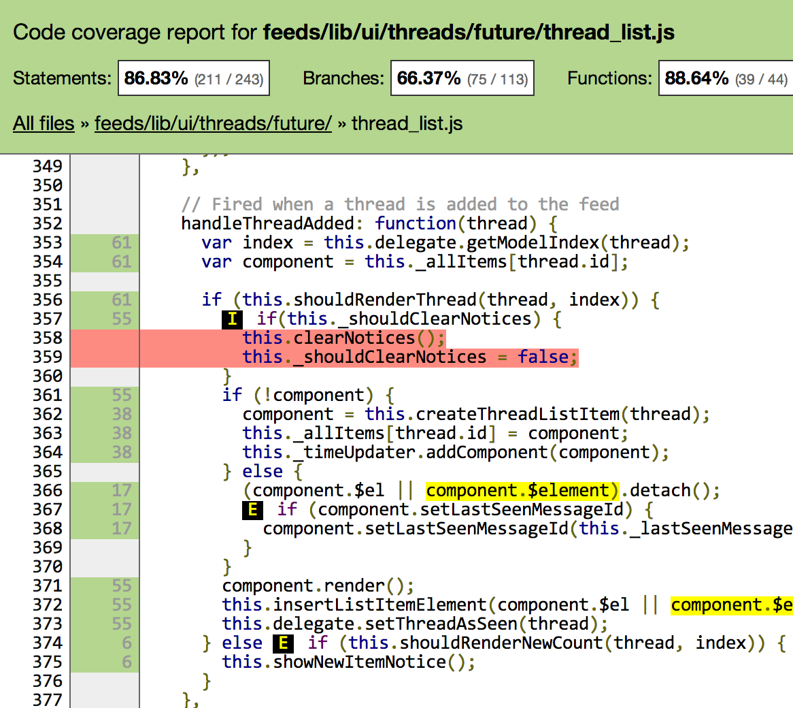
#sjsSugendran
Instanbul
http://gotwarlost.github.io/istanbul/

Slide 11
#sjsSugendran
Think about the API
How will others use this component?
Hack up different approaches
Be explicit – don’t repeat past mistakes

Slide 12
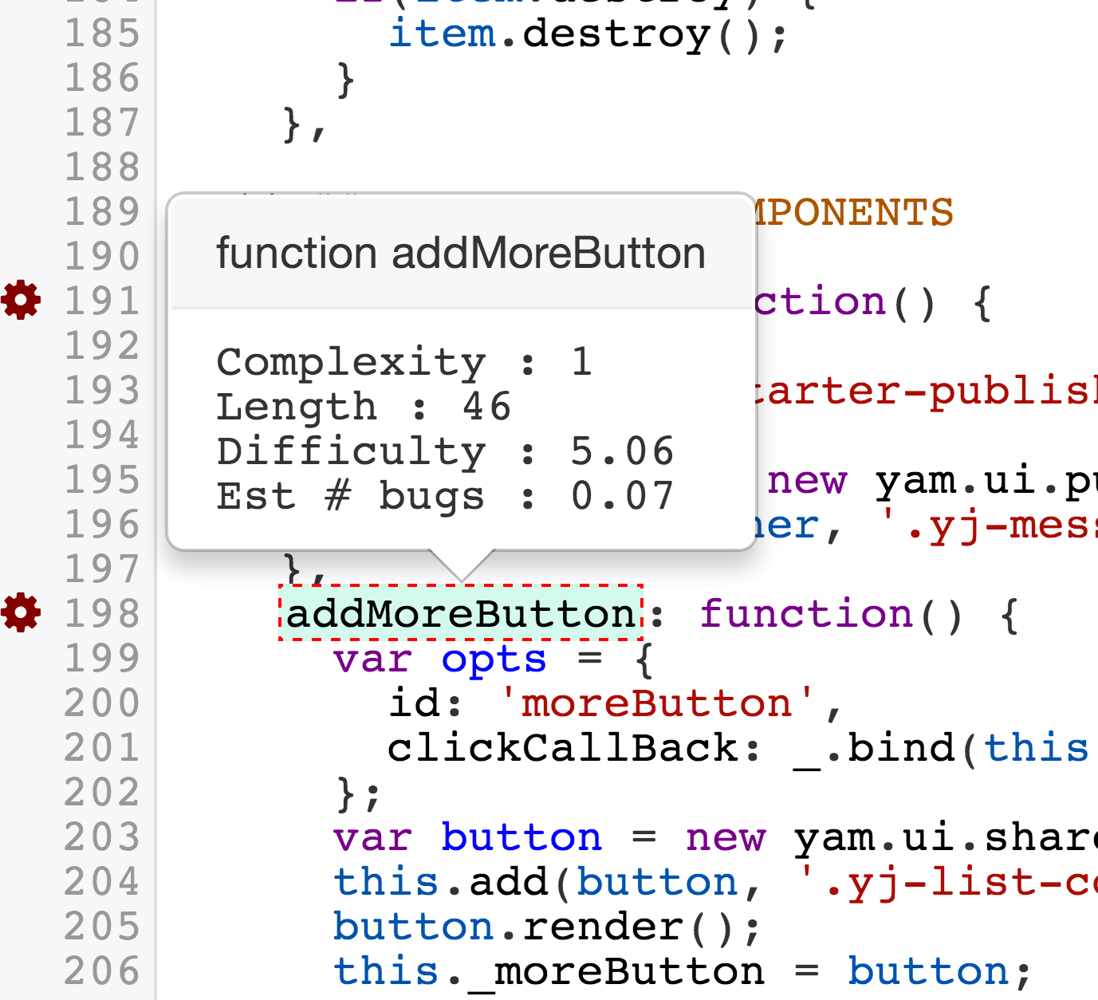
#sjsSugendran
Plato
http://platojs.org

Slide 13
#sjsSugendran
Keep the team in the loop
Get feedback before starting
Share the spec and answer questions
Everyone should understand the changes

Slide 14
#sjsSugendran
When is the project finished?
Don’t let scope creep
There will be diminishing returns
Remove the feature gate

Slide 15
#sjsSugendran
Avoid the long tail of bugs
Release early and have the team find bugs
The AB test system lets us test on Microsoft
Found features we didn’t account for

Slide 16
#sjsSugendran
Future Works?
Write down the things outside of scope
Will there be a phase 2 and 3?
Give other teams a head start

Slide 17
#sjsSugendran
Before and After
40% less code
Removed asynchronous rendering
Positive feedback from feed projects

Slide 18
#sjsSugendran
One more Thing
Released to all users

